Slide 1

CourseEz
A portal facilitating online mode of quizzes for college students
Roll No. | Name
190002 | A Kedarnath
190033 | Abhisar Bhardwaj
190176 | Arpit Maheshwari
190769 | Sarthak Gothalyan
190833 | Shubham Kumawat

Slide 2
Introduction
CourseEz is a course portal for conducting quizzes in online mode.
Professors or Instructors can use the portal to create courses, add students to a course, create quizzes with Multiple choice questions and Numerical based questions and view the class performance in quizzes.
Students can use the portal to attempt the quizzes in their enrolled courses and view their results.
The web app is developed using ReactJS for frontend and Springboot for Backend

Slide 3




Application Architecture
Rest API
Login
Course page
Services
User
Quiz Page
Spring Data JPA
On Course Page and Quiz Page, Professor would have extra options of adding the quiz, adding a new course and enrolling a student in a course.
Database

Slide 4
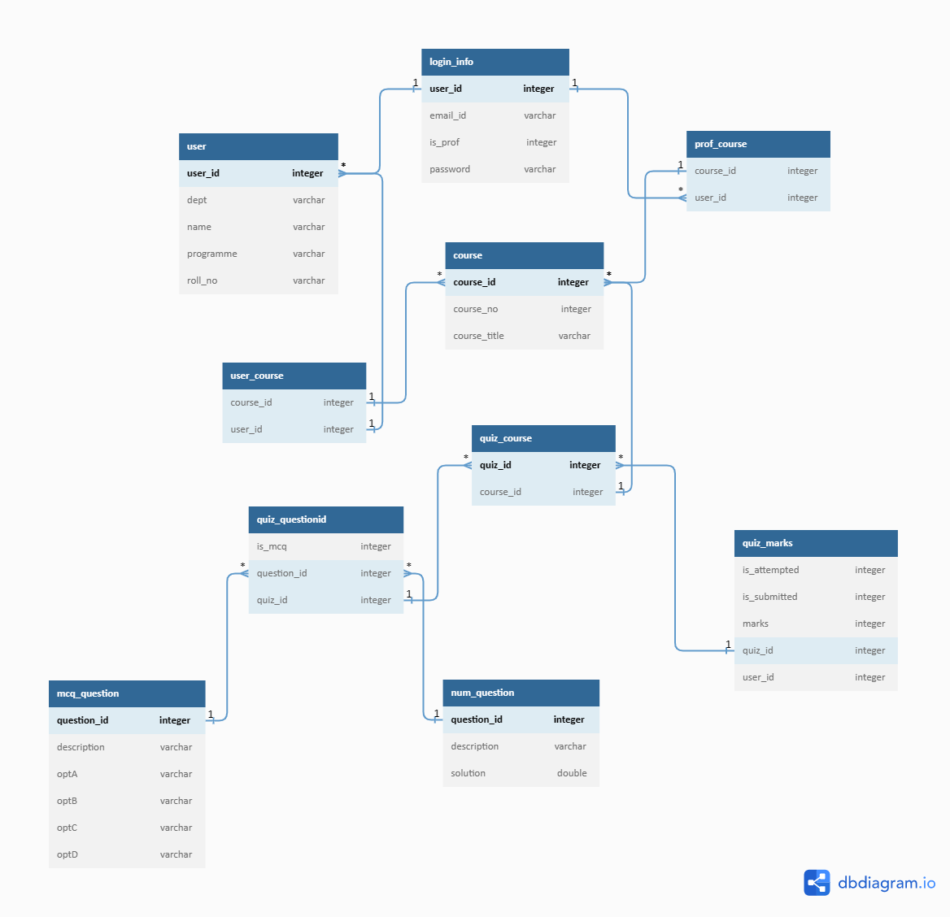
Table Relations

Slide 5
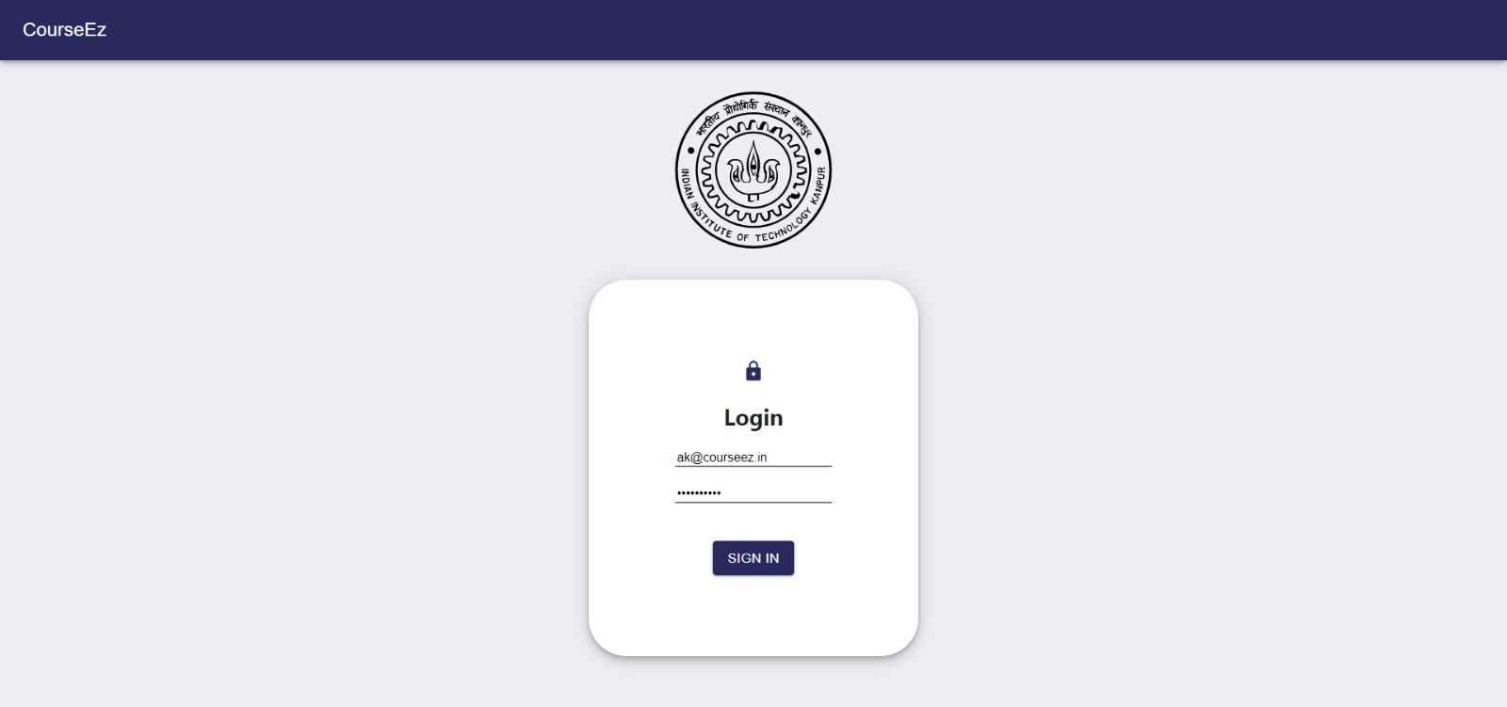
Login Page
This is the web app's first page. Here the user (professor/student) enters his credentials to login to the portal

Slide 6
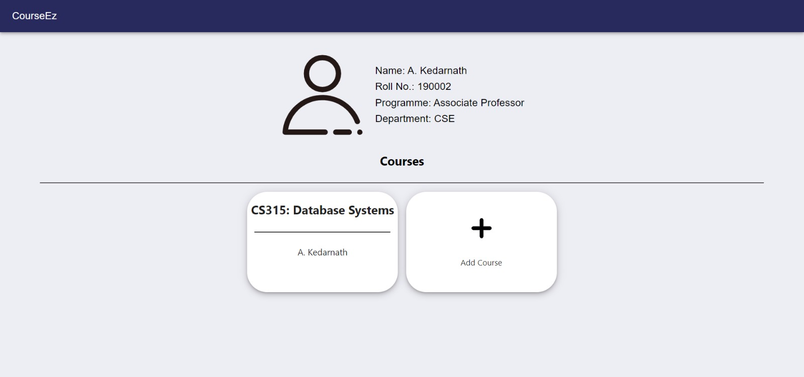
If an instructor logs into the portal, he gets option to either add a new course or view details of an existing course
Course homepage for instructor. There are 2 options- either open an existing course or add a new course

Slide 7
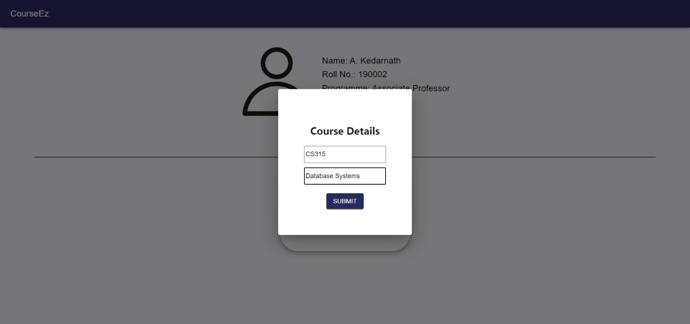
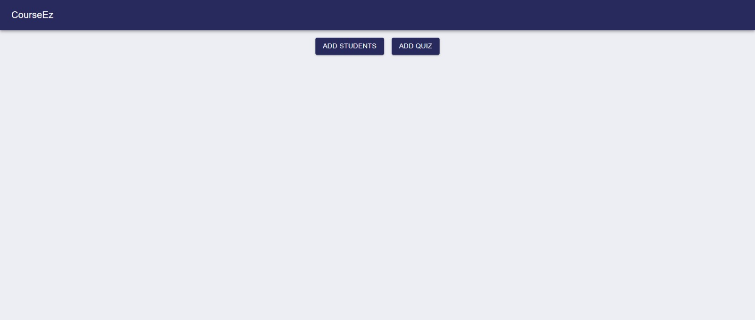
If the instructor had clicked on "Add Course", he is then required to provide the course number and title of the course
Once the course is created, two options are provided – admit students in the course and add quiz to the course

Slide 8
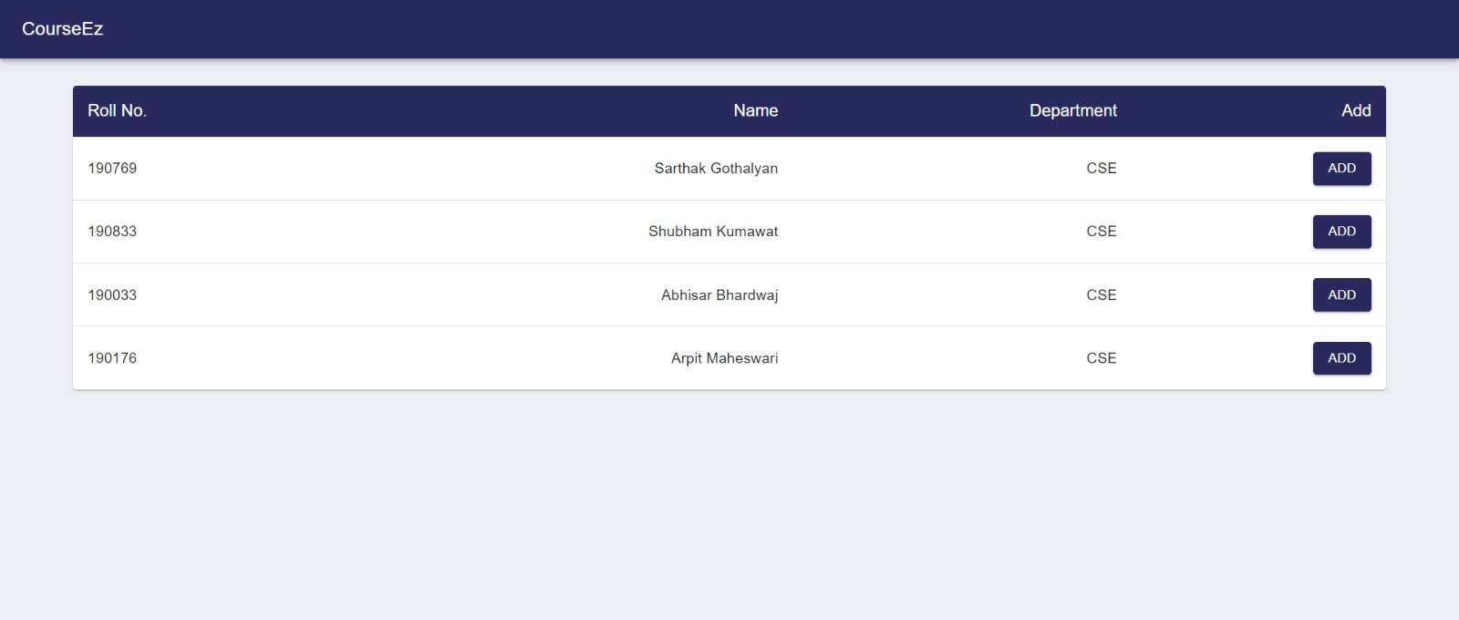
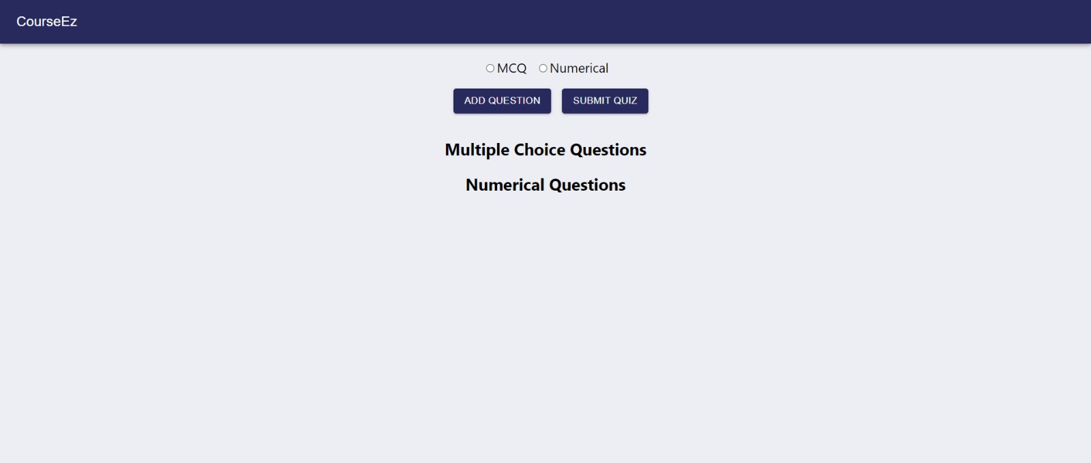
This page opens once Add Students is clicked
If Add Quiz was clicked, again 2 options are provided – either add MCQ or Numerical and then Create Quiz

Slide 9
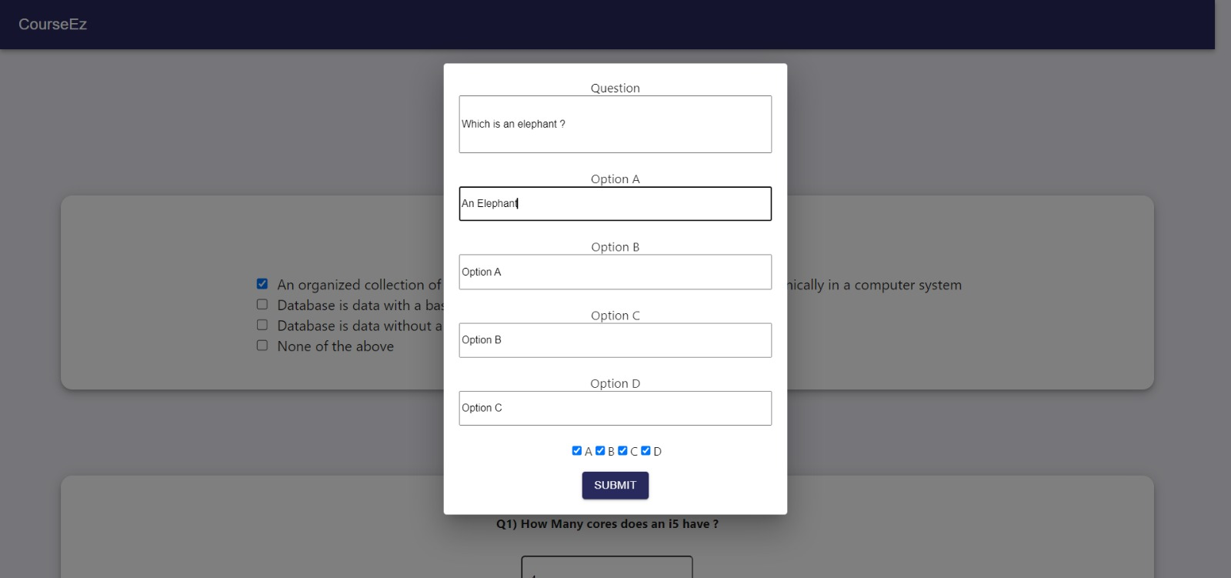
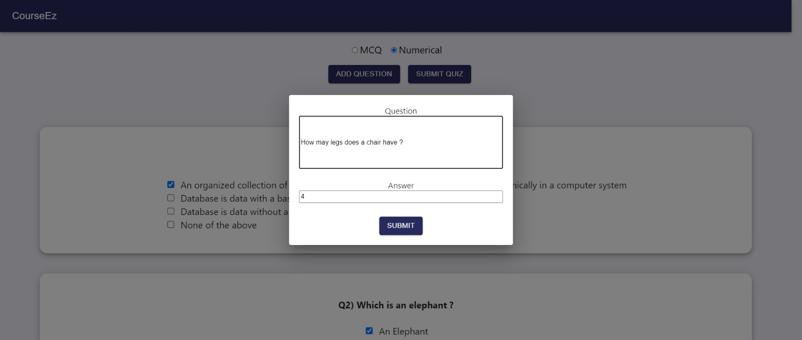
Creation of an MCQ
Creation of a numerical question

Slide 10
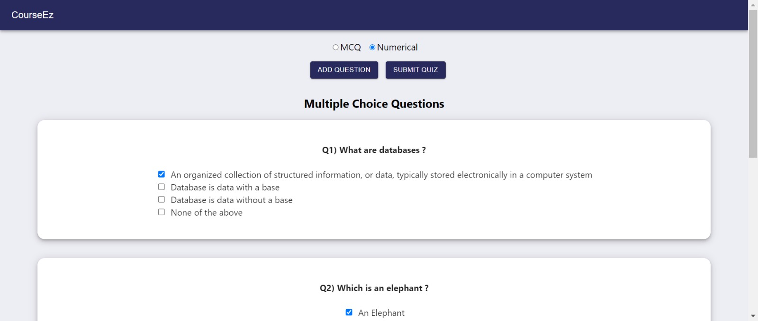
As the instructor adds questions to the quiz, those questions also keep on displaying along with their solutions

Slide 11
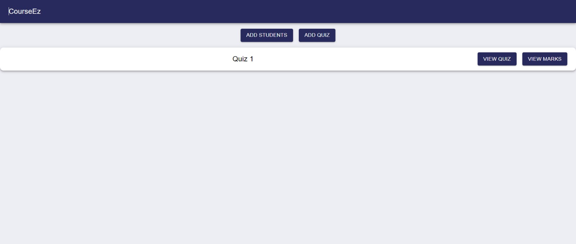
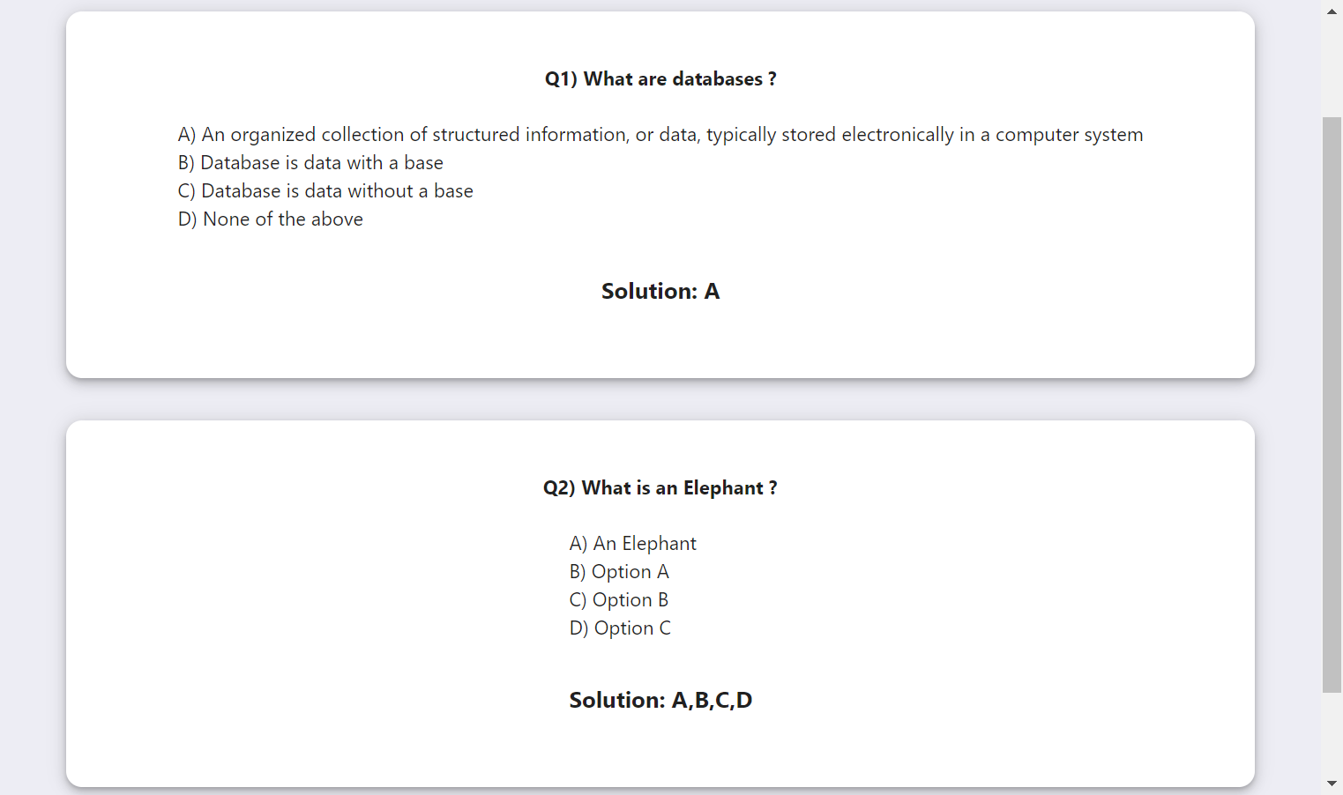
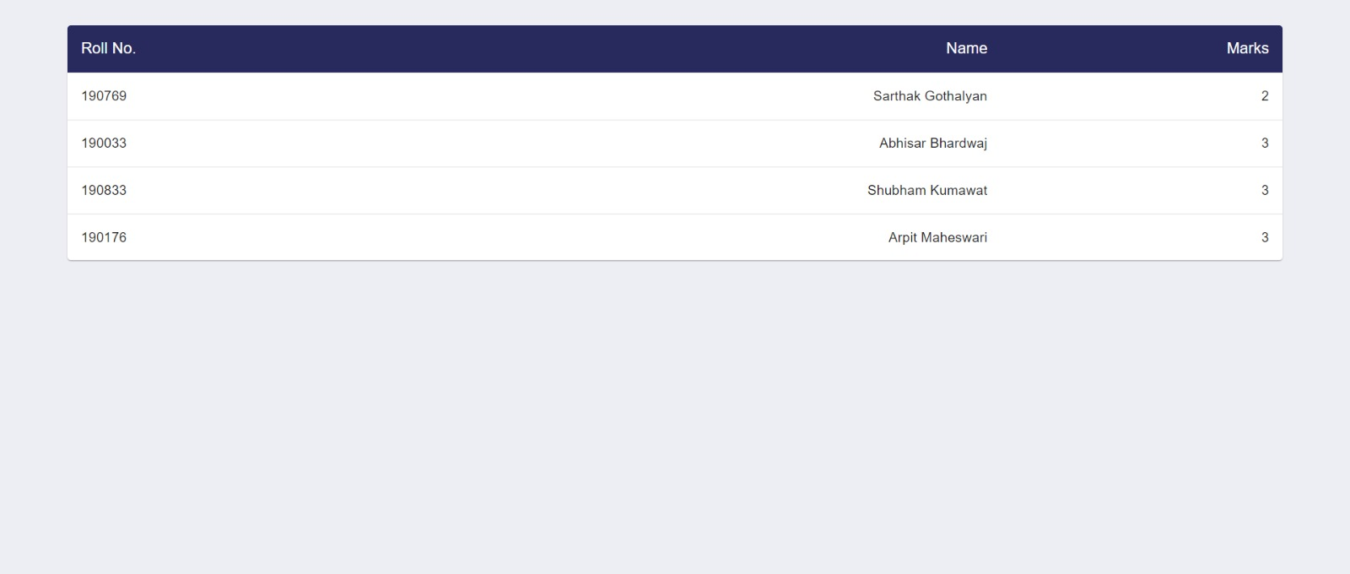
View Quiz
View Marks

Slide 12
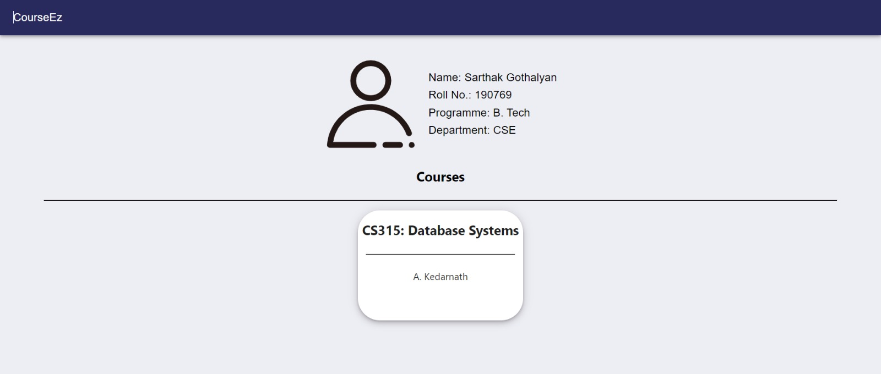
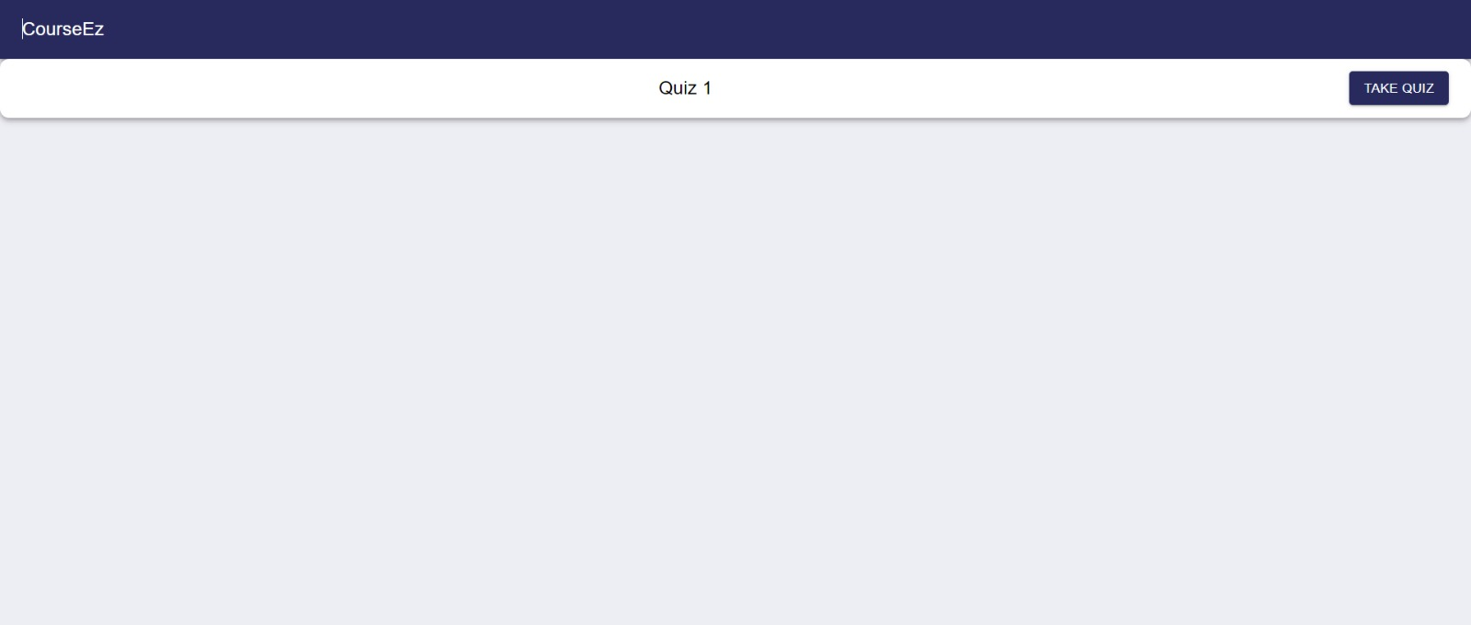
Student's homepage for the course
Student gets option to take quiz after selecting the course

Slide 13
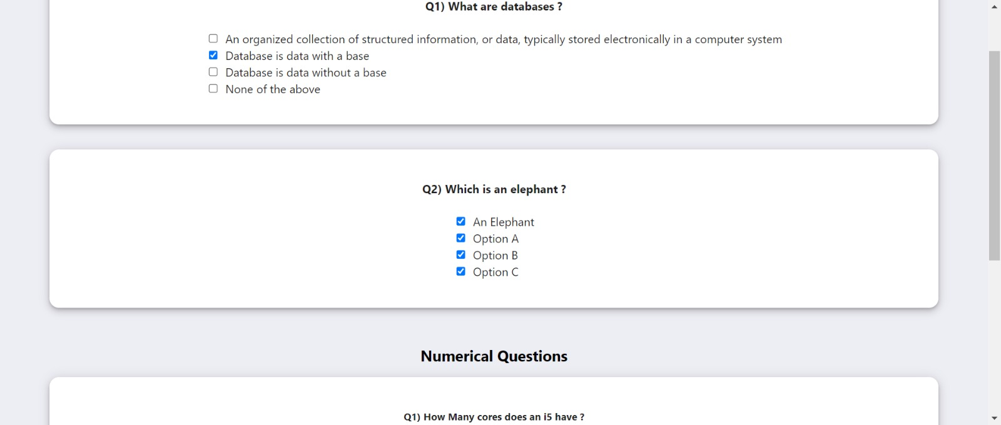
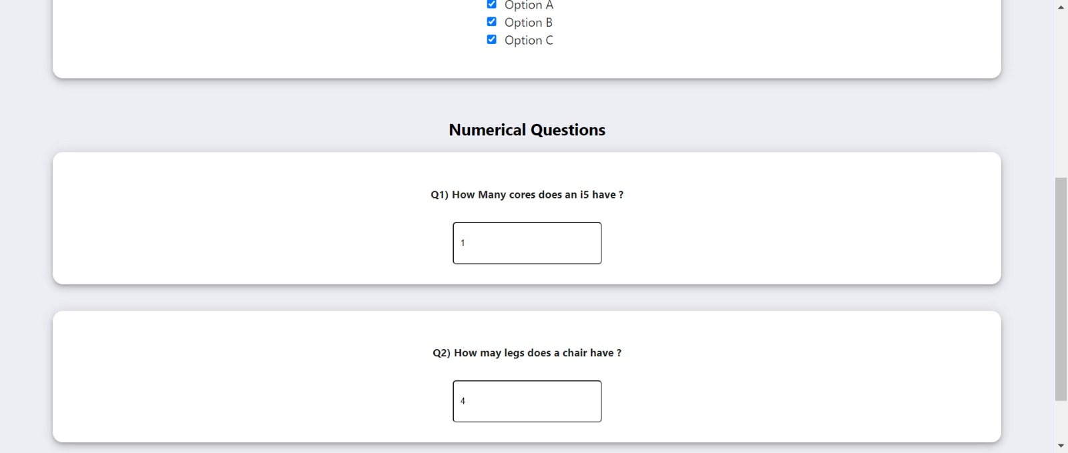
Quiz appearance for a student

Slide 14
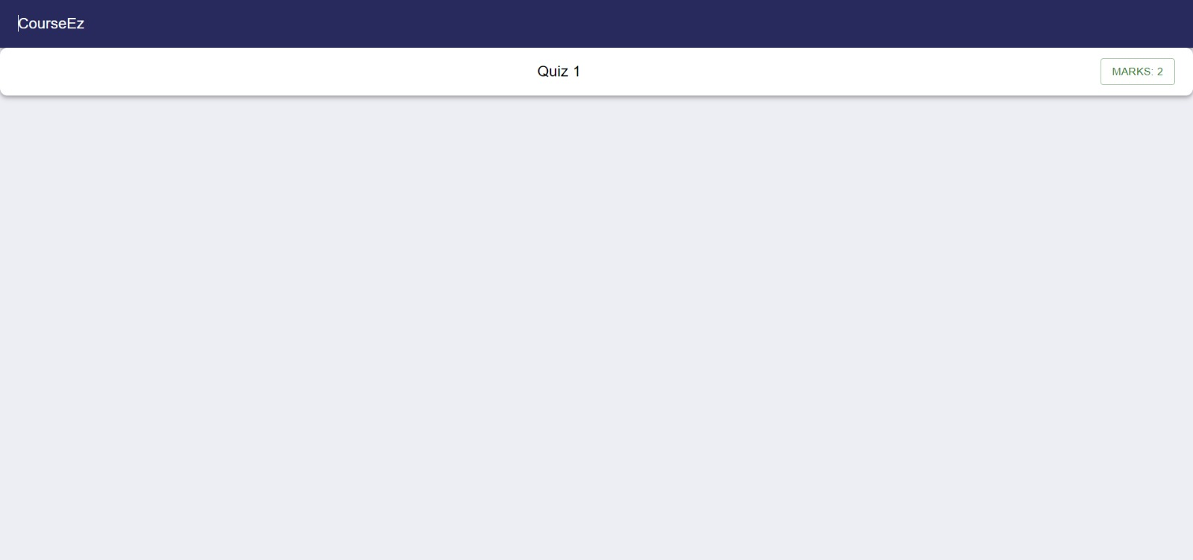
After attempting the quiz, the student can view his marks

Slide 15

Thank You !

